Slide 1
Wine Quality Testing using Machine Learning
Presented by
Ramanjali Medarametla , 700747141
Mounika Nelluri, 700745442
Sowmya Myla , 700741181

Slide 2
Roles , Responsibilities and Contribution
Project proposal and dataset creation: This step entails problem description, the creation of specific objectives and results, and the gathering of the dataset utilizing references. This work is completed by Ramanjali Medarametla, 700747141.
Data analysis and null value management: This phase involves importing the dataset, listing the necessary Python modules, looking for null values, and filling them with the mean value. This task is completed by Mounika Nelluri , 700745442 .
Model and Code Implementation: Multiple Machine Learning Algorithms are implemented using python flask, graphs are produced to determine the characteristics for modeling, and other correlation charts are produced. This task is completed Sowmya Myla, 7007431181.
Contributions:
Ramanjali Medarametla, 700747141 33%
Mounika Nelluri , 700745442 33%
Sowmya Myla, 7007431181 34%

Slide 3
Motivation
Accuracy and Consistency
Efficiency and Cost-Effectiveness
Scalability and Adaptability
Enhanced Decision-Making
Consumer Preferences
Innovation and Experimentation
Brand Differentiation

Slide 4
Objectives
Our main objective is to predict the wine quality using machine learning through Python programming language.
A large dataset is considered and wine quality is modelled to analyse the quality of wine through different parameters like fixed acidity, volatile acidity etc.
All these parameters will be analysed through Machine Learning algorithms like random forest classifier, Voting Classifier, Gradient Boosting classifier algorithm etc.
Output obtained would further be checked for correctness and model will be optimized accordingly.
By achieving these objectives, Machine learning can provide valuable insights for winemakers to improve their production processes, make informed decisions, and meet consumer preferences effectively.

Slide 5
Related Work
Lee, S., Park, J., & Kang, K [1 ] proposed a new way of predicting taste preferences for wines using a decision tree, and evaluated it using the Wine Quality Data Set from the UCI Machine Learning Repository. Results suggest that this model could offer untutored consumers a better chance of selecting a high-quality wine.
Kumar, S., Agrawal, K., & Mandan, N [2] In their paper, done a research involved with the techniques Naïve bayes, Support Vector Machine and Random forest Classifier out of which Support Vector Machine gave the highest accuracy.
Trivedi, A., & Sehrawat, R [3]In their paper, developed and analysed two classification algorithms, which targeted the Wine dataset following different approaches to predict the dependent variables. It is observed that Random-forest based on decision tree generated better predictions than Logistic Regression.

Slide 6
Problem Statement
Older the wine the better it tastes, this is not always true as some wines are made to enjoy right away. There are several elements that considered into wine quality and many wines do not benefit from aging even the Wine can get spoiled. To judge the quality of wine we need to understand the correlation among the wine elements.
With the advanced Machine Learning techniques, we now are planning a tool to have the flexibility to look for a solution to check the quality of wine rather investing time and money.

Slide 7
Proposed Solution
In this study, different machine learning algorithms are applied to the dataset, and classification is done using different techniques, with the maximum accuracy being achieved by Gradient Boosting Classifier Algorithm.
With the dataset used for the experiment, it is obvious that the model enhances good quality wine prediction precision and accuracy.
This research can be expanded further by analyzing the customer preferences and wine as Machine learning models can provide consumers customized recommendations based on their taste preferences and prior experiences by merging this data with wine attributes.

Slide 8
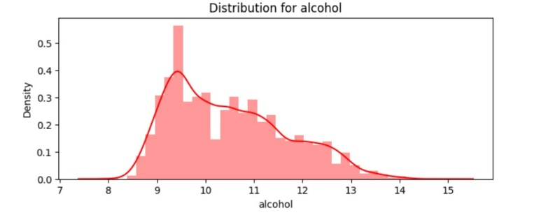
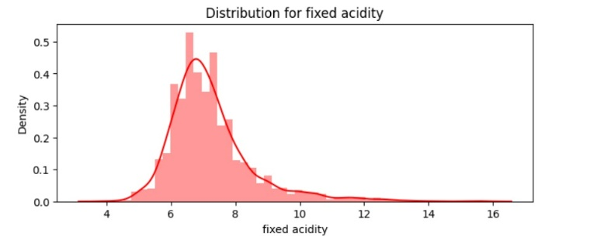
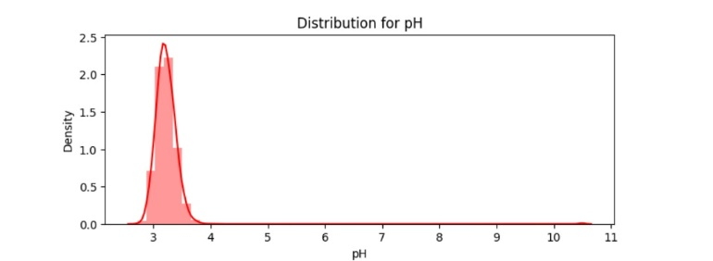
Results/Simulations

Slide 9
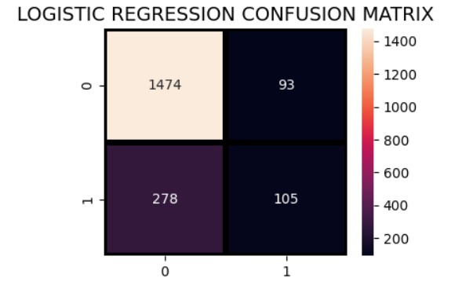
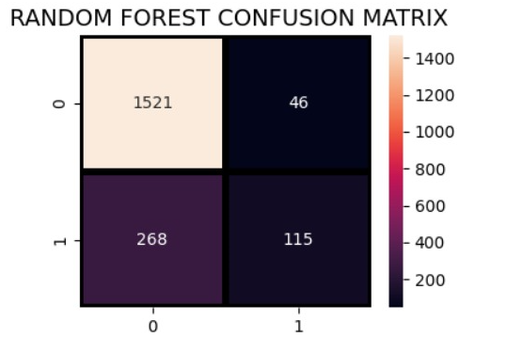
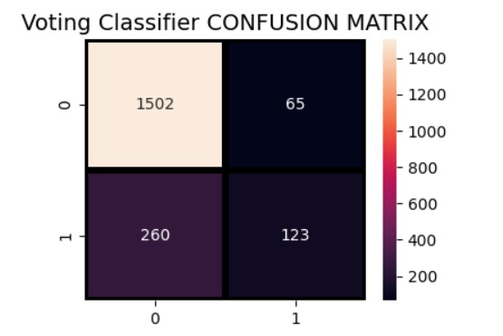
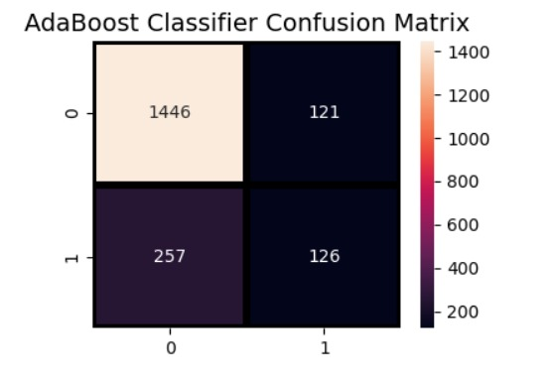
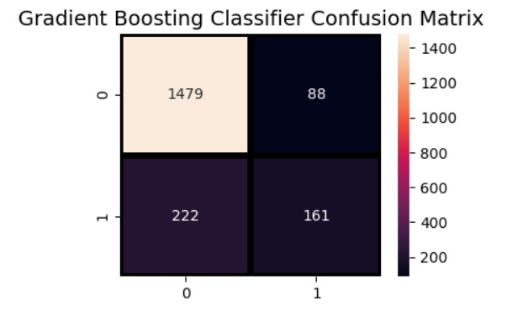

Slide 10
References
Lee, S., Park, J., & Kang, K. (2015). Assessing wine quality using a decision tree. 2015 IEEE International Symposium on Systems Engineering (ISSE). doi:10.1109/syseng.2015.7302752
Kumar, S., Agrawal, K., & Mandan, N. (2020). Red Wine Quality Prediction Using Machine Learning Techniques. 2020 International Conference on Computer Communication and Informatics (ICCCI). doi:10.1109/iccci48352.2020.9104095
Trivedi, A., & Sehrawat, R. (2018). Wine Quality Detection through Machine Learning Algorithms. 2018 International Conference on Recent Innovations in Electrical, Electronics & Communication Engineering (ICRIEECE). doi:10.1109/icrieece44171.2018.9009111
A. Abdelhalim and I. Traore, “A new method for learning decision trees from rules,” IEEE International Conference on Machine Learning and Applications, pp. 693–698, Dec. 2009.

